Slide 1
Solar radiation & the Earth’s energy budget
Silvia Caldararu
Email: caldaras@tcd.ie

Slide 2

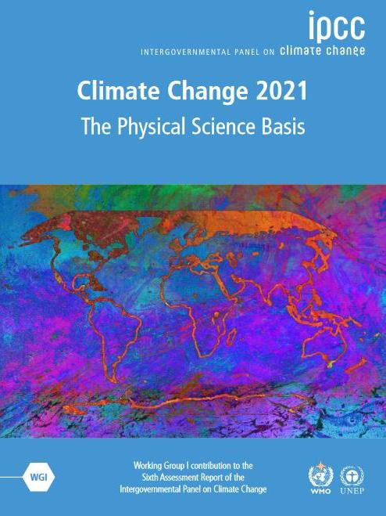


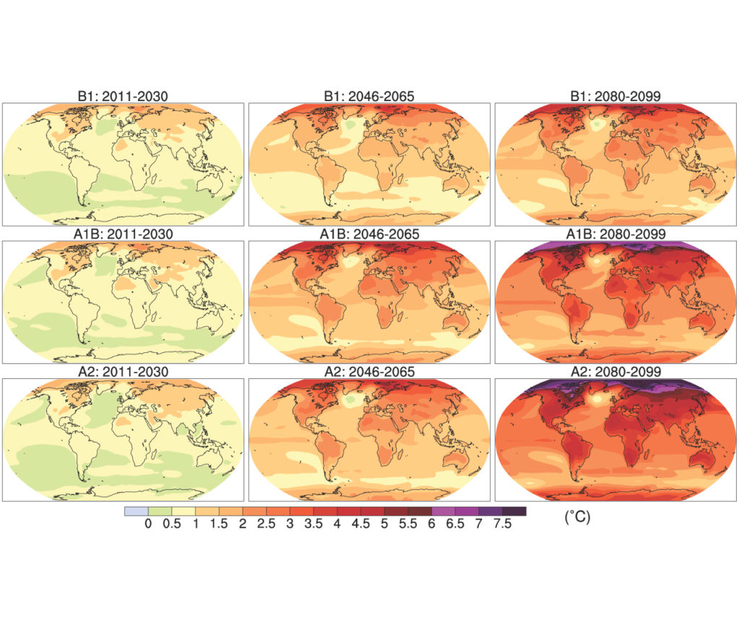
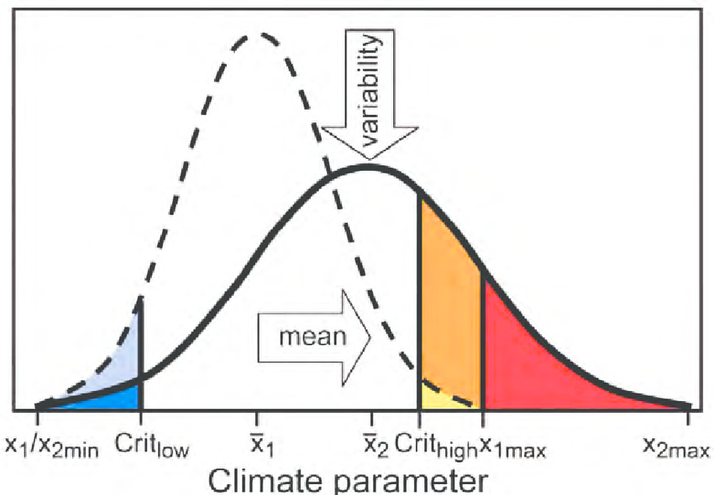
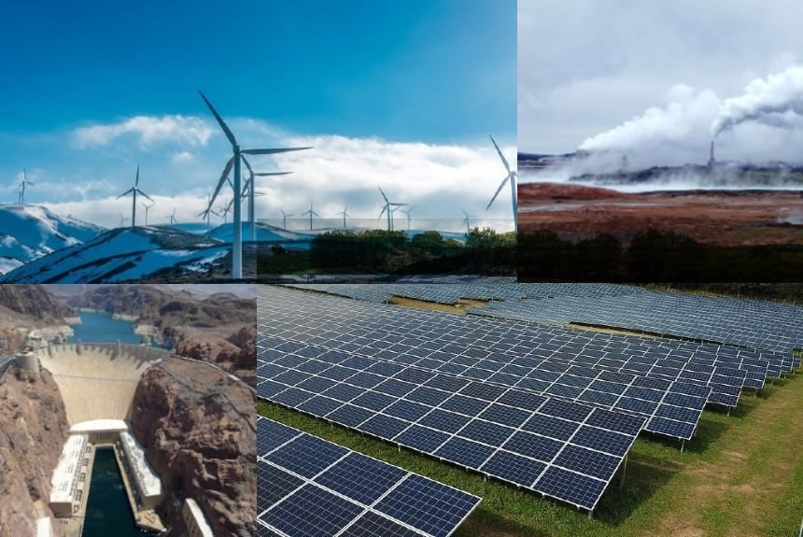
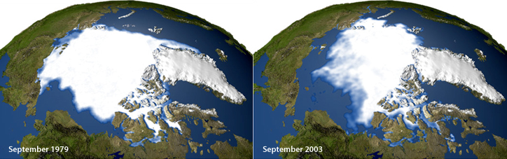
Atmosphere
Climate fundamentals
Predicting climate
Atmosphere
Global C cycle
IPCC report
Earth system models
Climate impacts
Climate solutions
Extreme events
Tipping points
Sea ice, ice caps,
Energy
Mitigation
Nature-based solutions

Slide 3
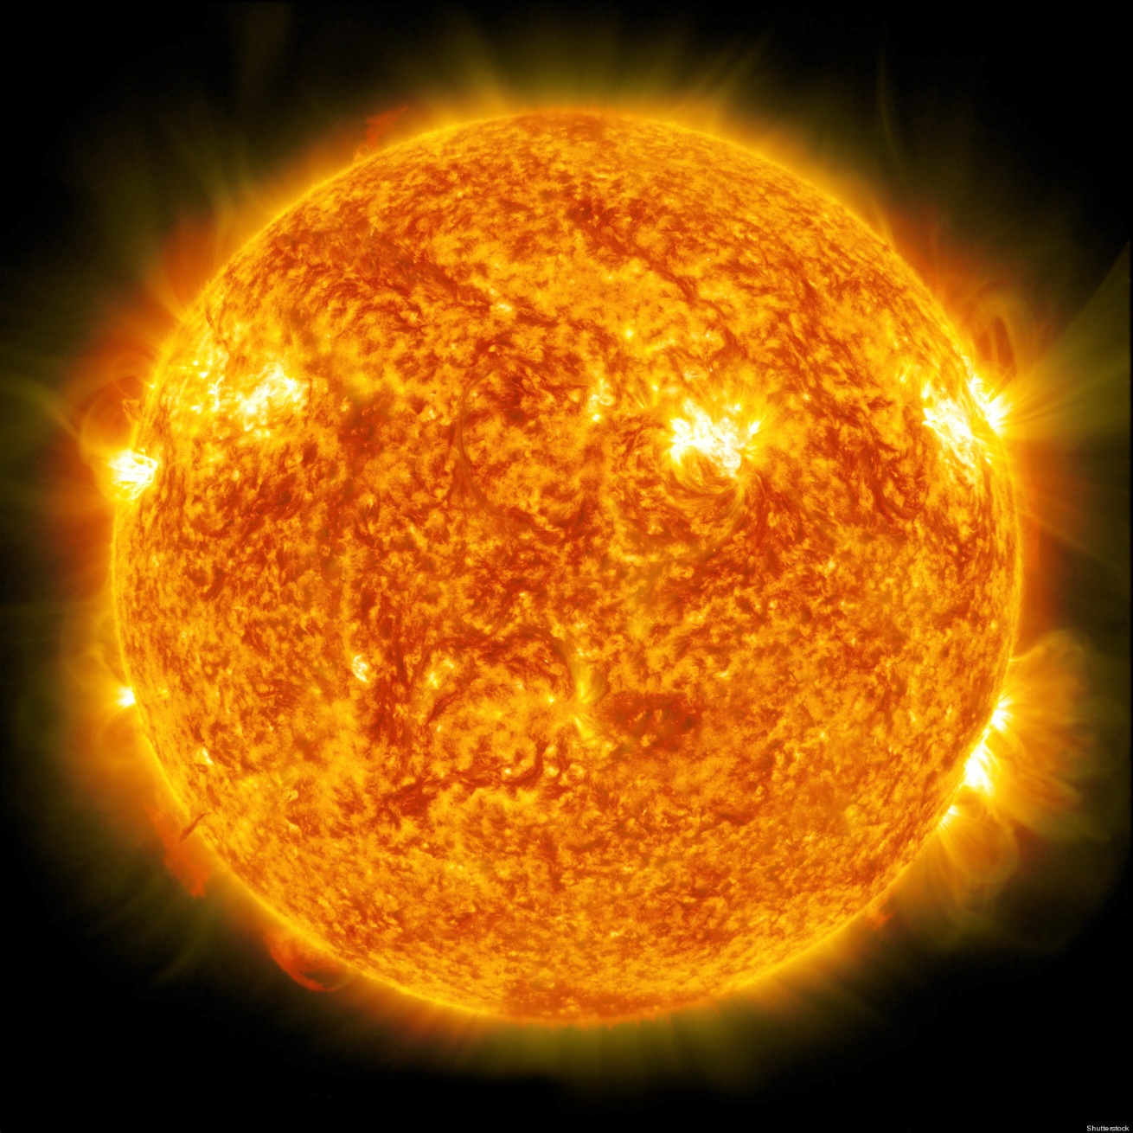
The main driver of average long-term climate is incoming solar radiation

Slide 4
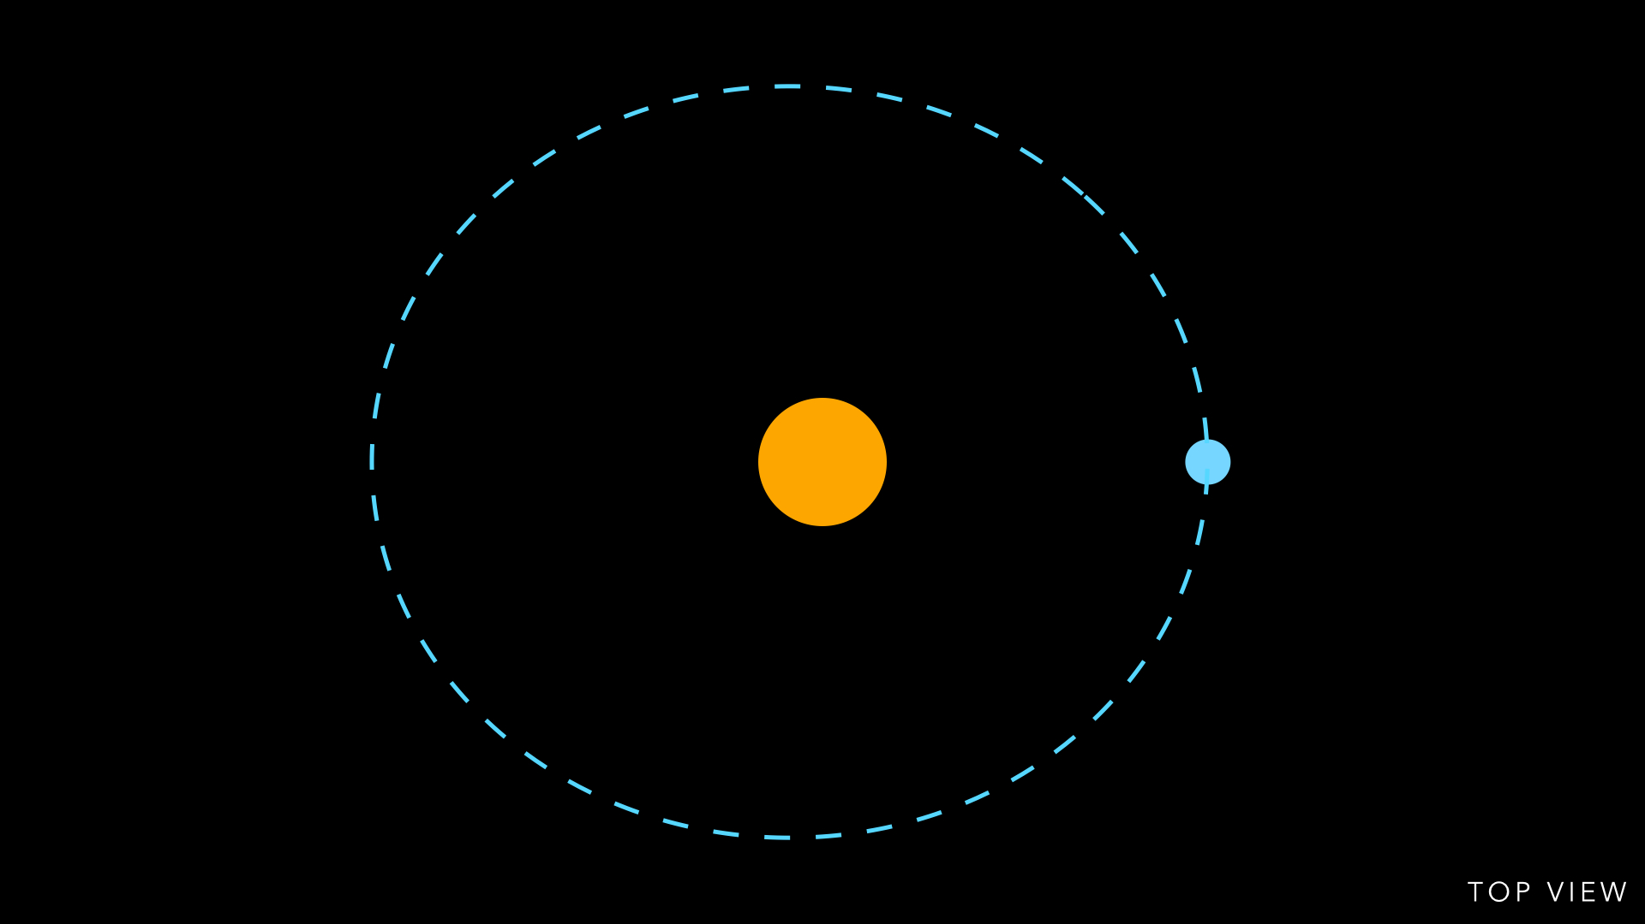
Average radiation reaching the surface determined by distance from the sun
Orbit is oval-shaped
Sun off-center

Slide 5
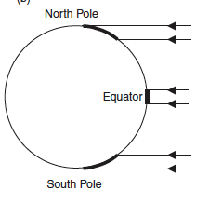
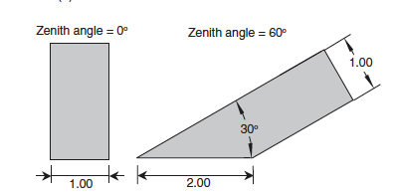
Latitudinal variation in insolation driven by different incidence angles
Close to perpendicular rays – more solar radiation per unit surface
Notes:
Ecological Climatology, chapter 4

Slide 6
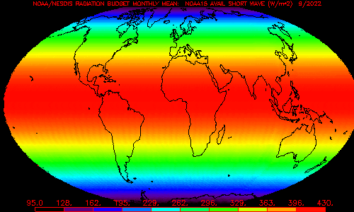
Observed mean annual top of the atmosphere radiation

Slide 7
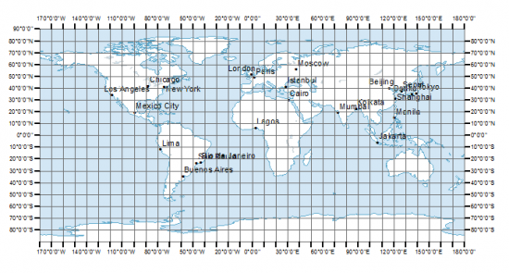
Mapping and displaying global data

Slide 8
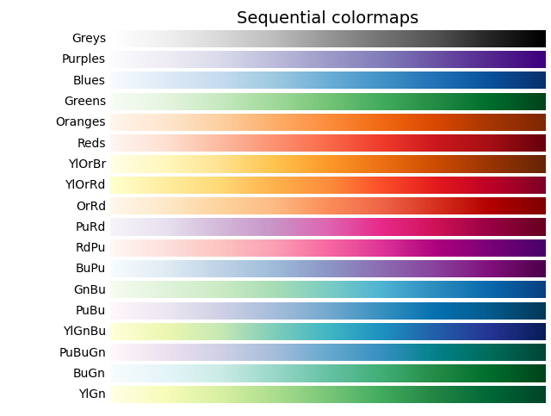
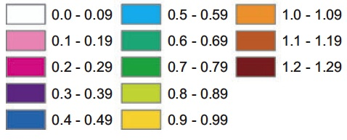
Mapping and displaying global data

Slide 9
Mapping and displaying global data

Slide 10
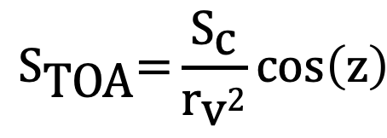
How to calculate solar radiation at the top of the atmosphere
Solar constant 1364 W/m2
Average solar radiation per unit area reaching the Earth
$${\text{S}}_{\text{TOA}}\text{=}\frac{{\text{S}}_{\text{c}}}{{\text{r}}_{\text{v}\text{2}}}\text{cos}\left(\text{z}\right)$$
Radius vector
Actual distance from the sun expressed relative to the mean distance
Zenith angle
Adjusts for the incidence angle

Slide 11
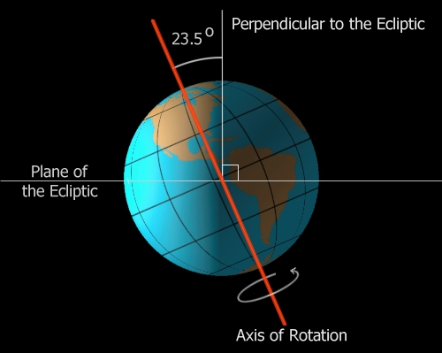
Axial tilt

Slide 12
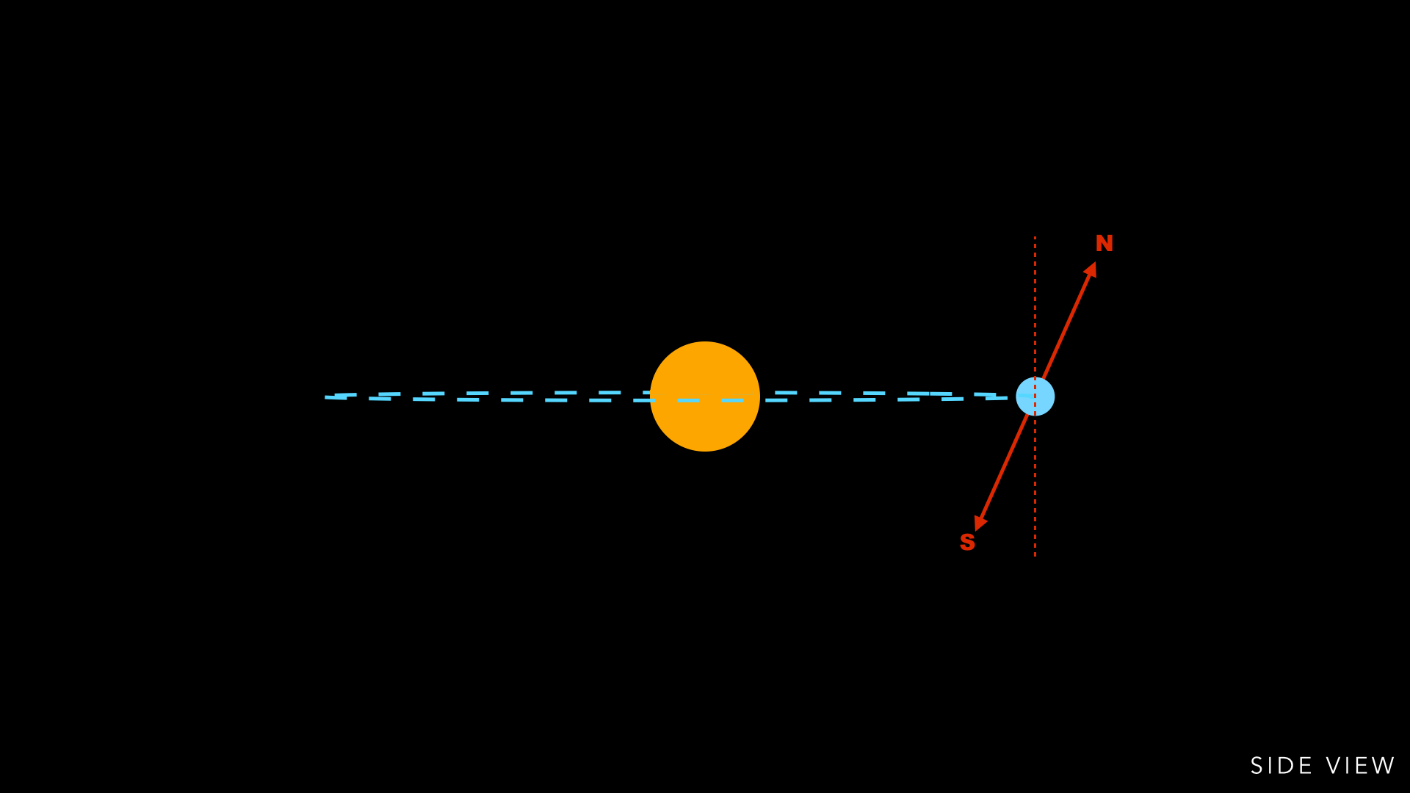
Axial tilt

Slide 13
A tilted axis means that perpendicular rays do not occur at equator

Slide 14
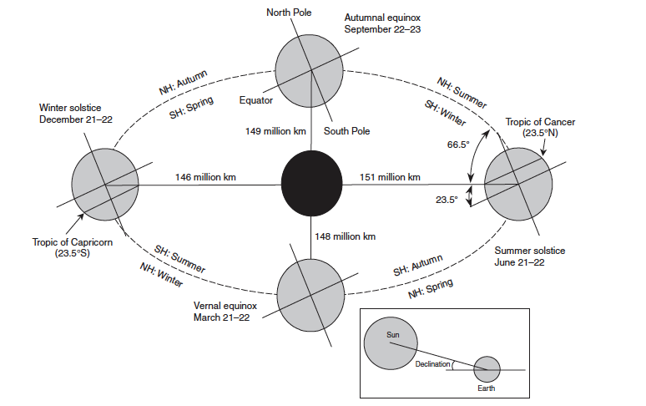
The Earth’s orbit and the seasons
Notes:
Ecological Climatology ch. 4

Slide 15
What drives surface temperature?
Incoming radiation
Outgoing radiation
Driven by sun's characteristics and Earth's distance from the Sun
Driven by how much radiation is reflected by the surface, and how much it's emitted back to space

Slide 16
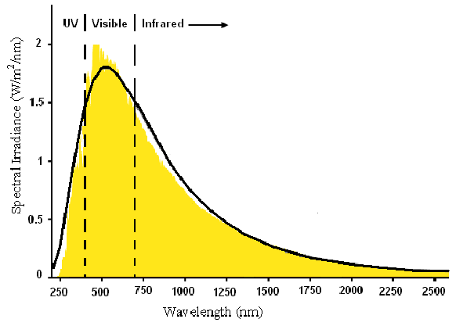
Solar radiation spectrum at the top of the atmosphere

Slide 17
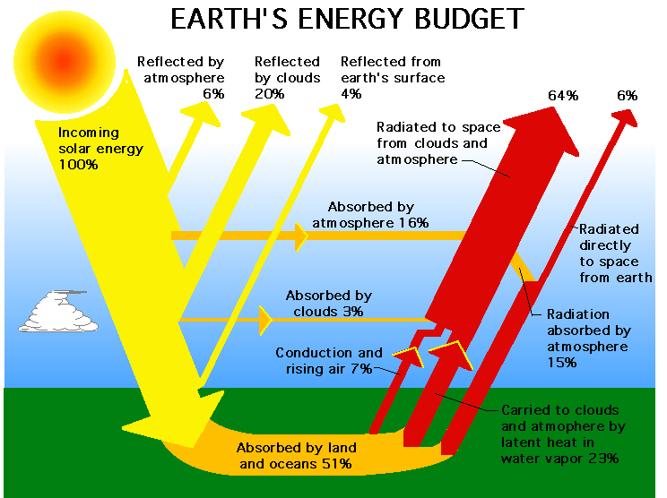

Slide 18
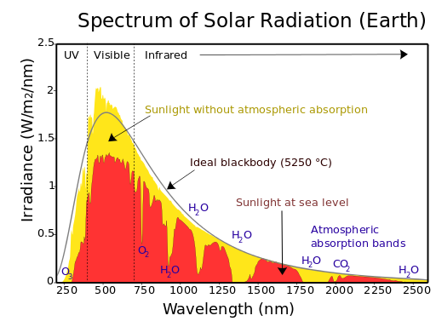
Solar attenuation by the atmosphere

Slide 19
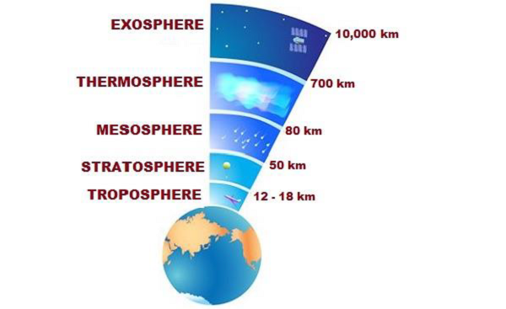
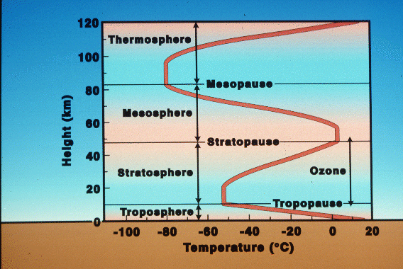
Structure of the atmosphere

Slide 21

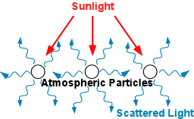
Reflection: Rayleigh scattering
Reflection off molecules in the atmosphere
Blue wavelengths are scattered ~4 times more than longer wavelength – this is why the sky is blue!

Slide 22
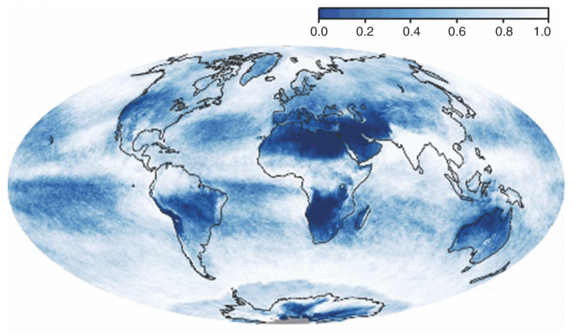
Reflection by clouds

Slide 23
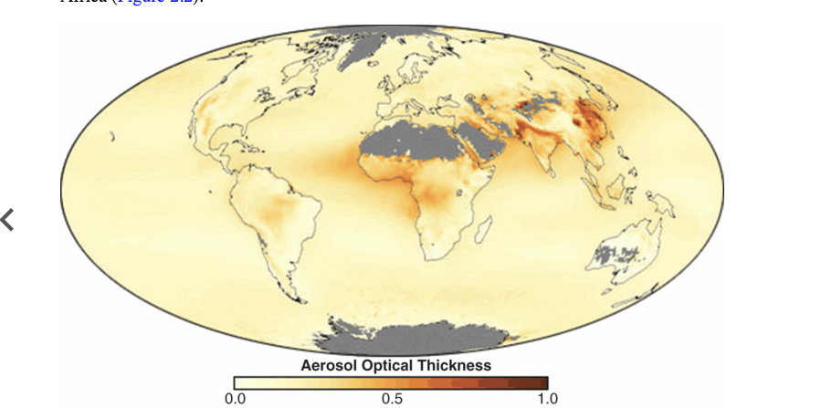
Reflection by aerosols
Aerosols are atmospheric particles or droplets of various origins and sizes
They scatter and reflect solar radiation
More in the second part of this lecture

Slide 24
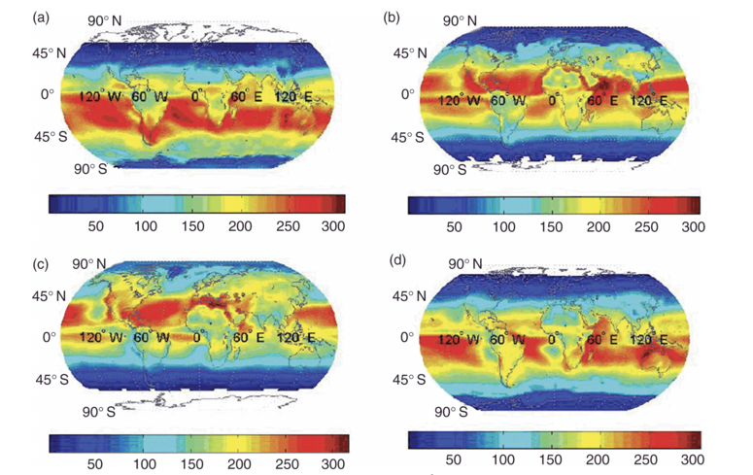
Net radiation reaching the surface
Jan
Apr
Jul
Oct
Notes:
Essentials of the Earth’s Climate System, chapter 2

Slide 26
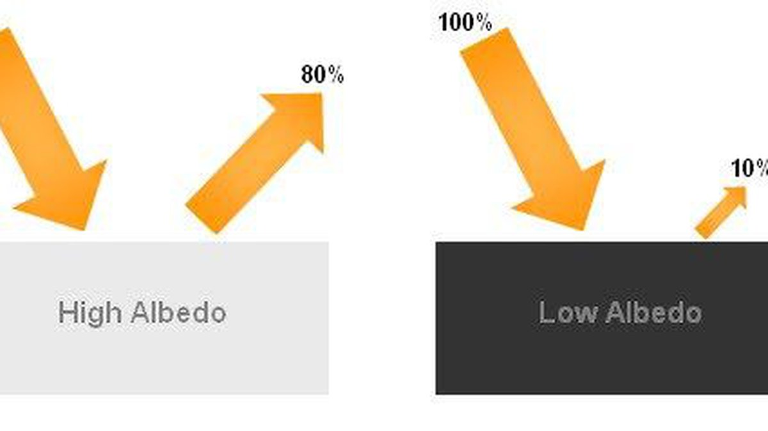
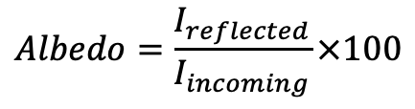
Reflection: albedo
$$Albedo=\frac{I_{reflected}}{I_{incoming}}×100$$

Slide 27
Rank these surfaces from low to high albedo
Desert sand
Fresh asphalt
Open ocean
Green grass
Fresh snow
Conifer forest
Deciduous forest

Slide 28
Rank these surfaces from low to high albedo
Fresh asphalt: 0.04
Open ocean: 0.06
Conifer forest: 0.09-0.15
Deciduous forest: 0.15-0.18
Green grass: 0.25
Desert sand: 0.40
Fresh snow: 0.80-0.90

Slide 29
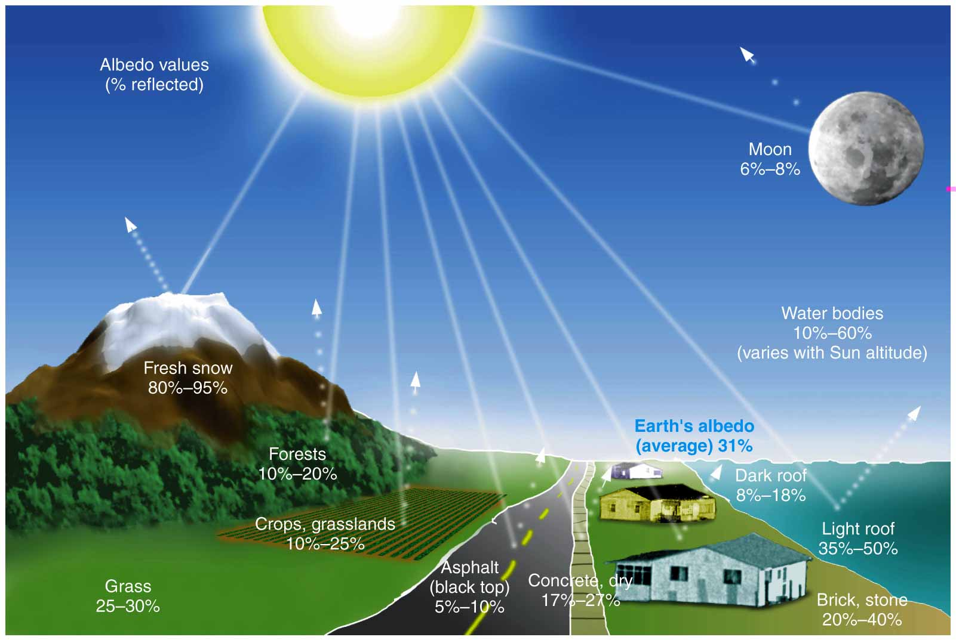
Reflection: albedo

Slide 31
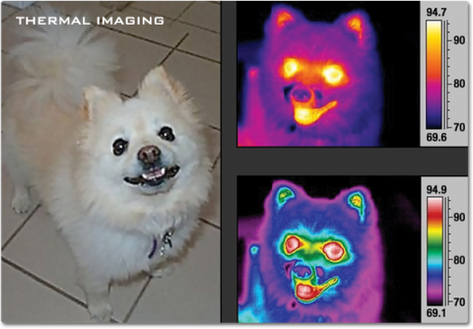
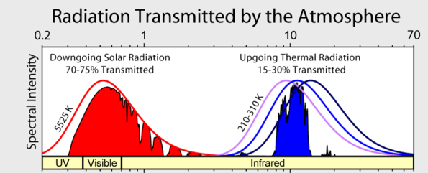
Infrared radiation and heat
Earth’s surface emits longwave, infrared radiation i.e. heat back into the atmosphere

Slide 32
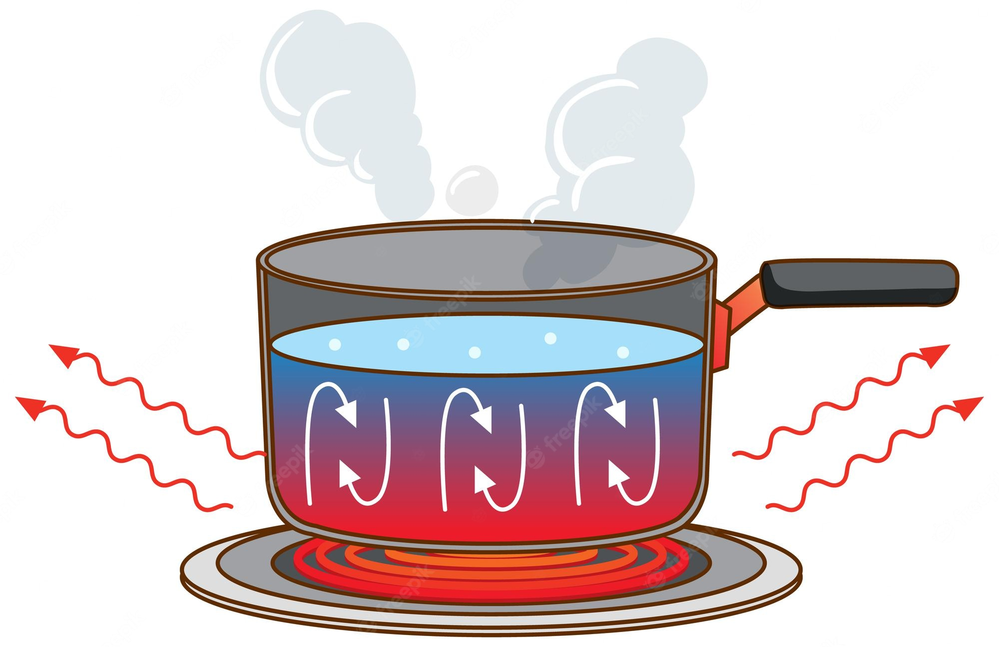
Sensible heat
Exchange of energy associated with a change of temperature

Slide 33
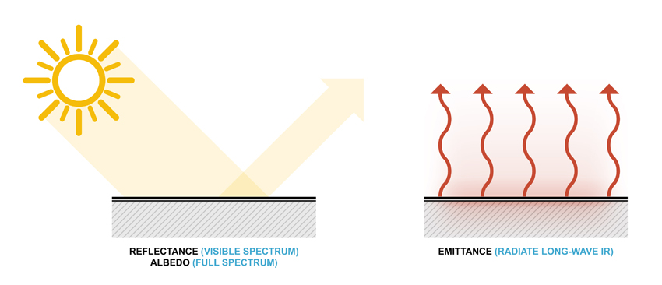
Sensible heat - emissivity

Slide 34

Latent heat
Energy transfer associated with a change of state e.g. from liquid to gas

Slide 35
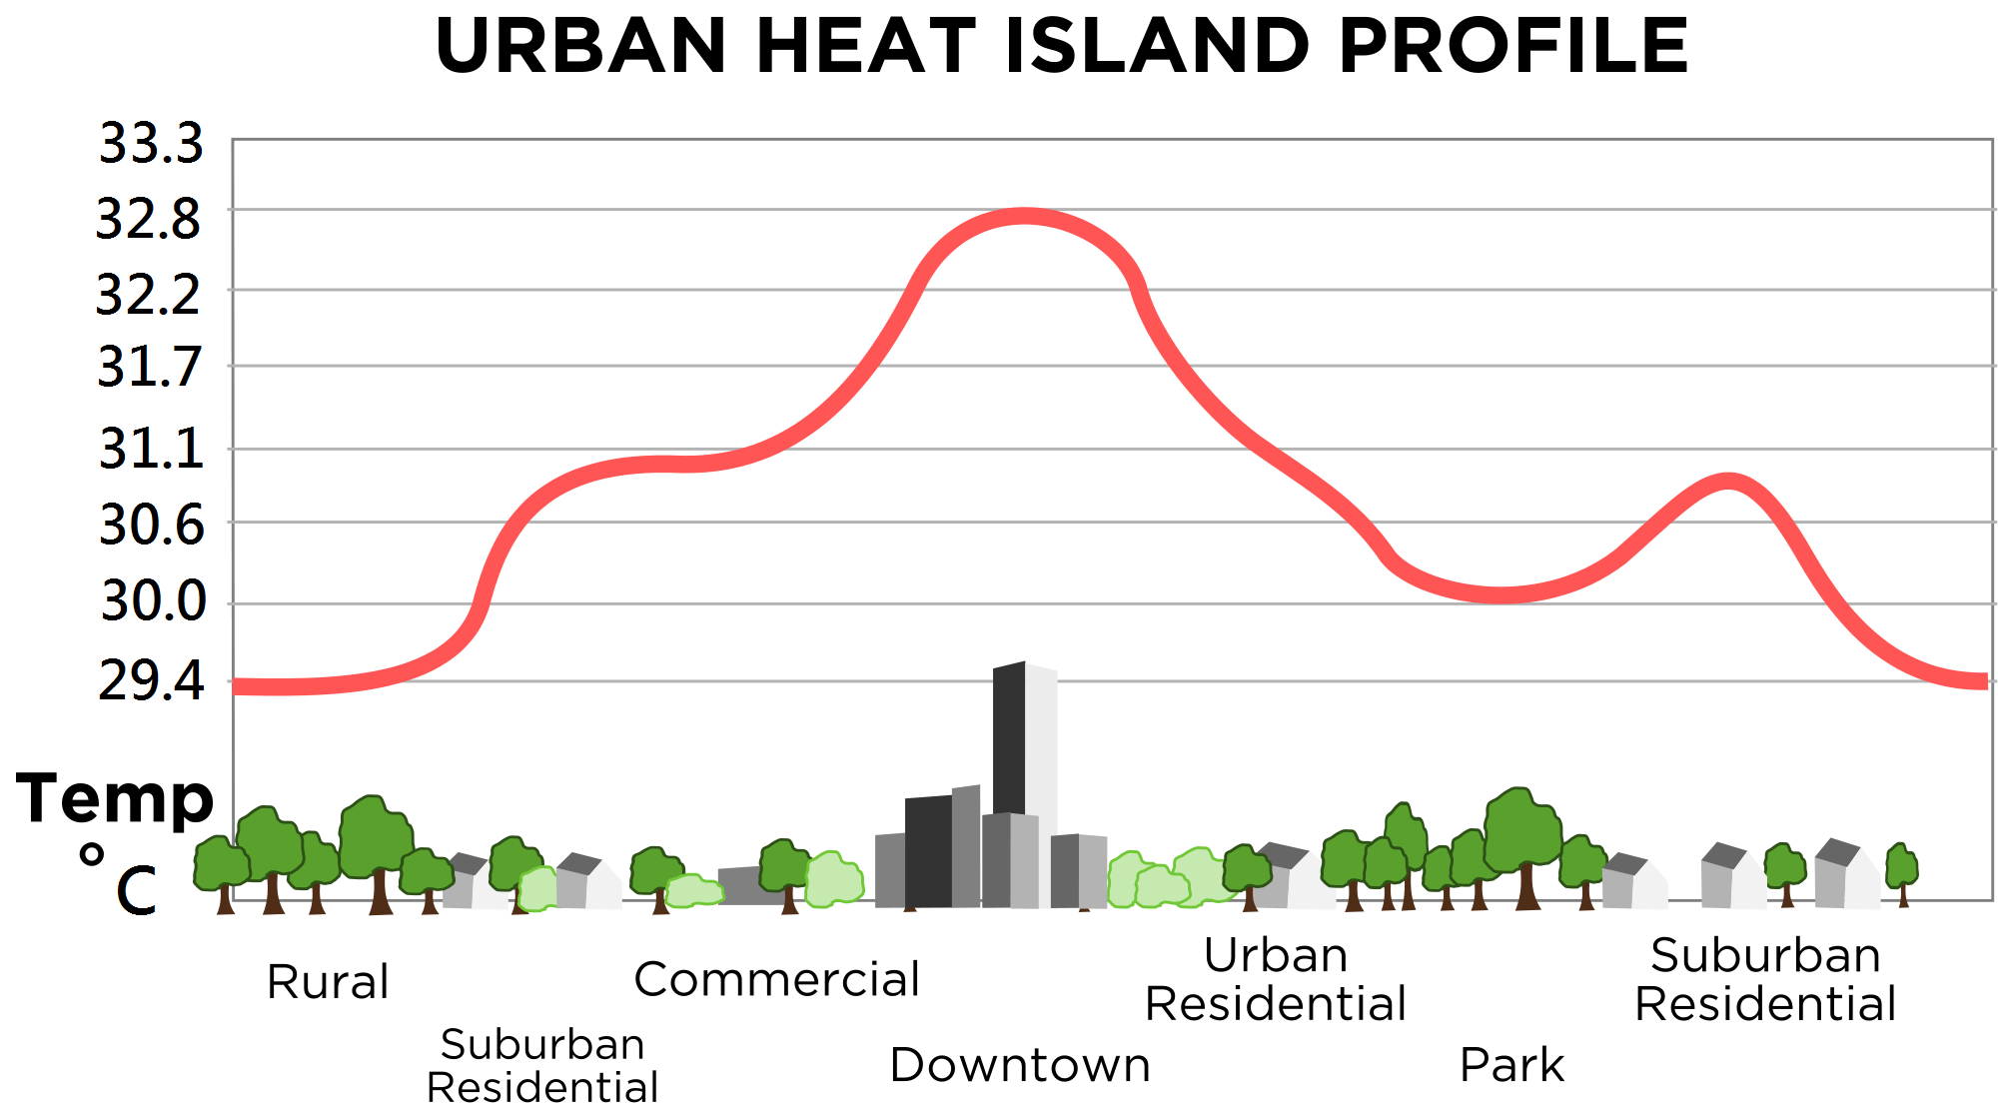
Urban heat island

Slide 36
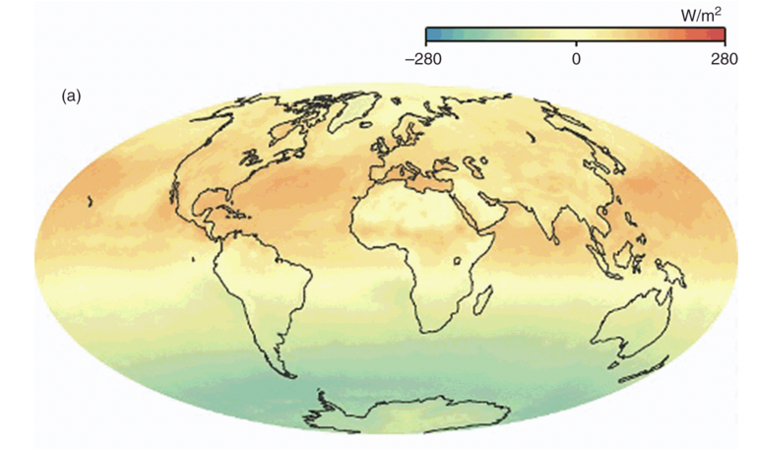
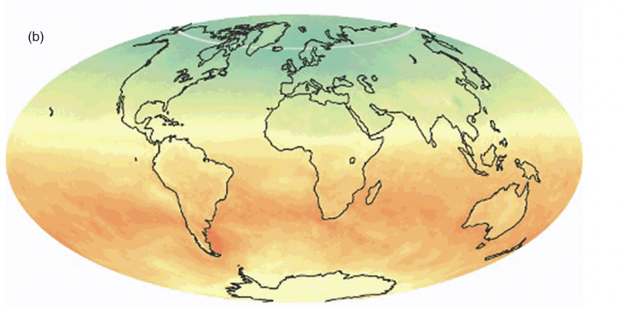
Net radiation flux at the surface
Jul
Dec

Slide 38
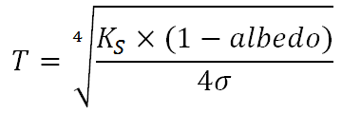
Earth's average temperature calculated from theoretical energy budget
Earth's actual average temperature
-19.5 C
?
14 C

Slide 40
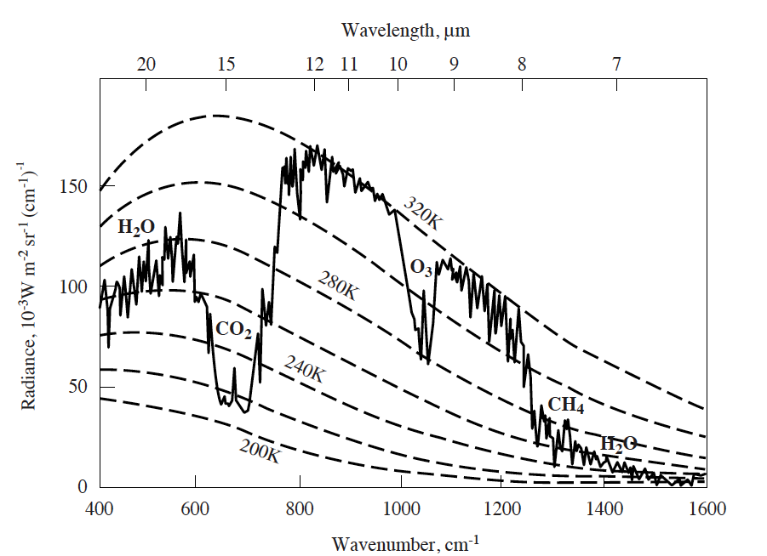
What is a greenhouse gas (GHG)?
Greenhouse gases are atmospheric compounds that trap infrared radiation emitted by the Earth’s surface

Slide 41
Water vapour
Well mixed gases:
CO₂
CH₄
N₂O
HFCs
Aerosols

Slide 42
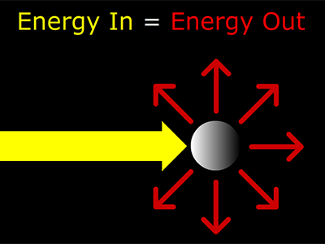
Radiative forcing
IPCC definition:
‘the change in net (down minus up) irradiance (solar plus longwave; in W m–2) at the tropopause after allowing for stratospheric temperatures to readjust to radiative equilibrium, but with surface and tropospheric temperatures and state held fixed at the unperturbed values’.

Slide 43
Global warming potential
Gas properties give its radiative efficiency
A measure of how much energy the emissions of 1 ton of a gas will absorb over a given period of time, relative to the emissions of 1 ton of carbon dioxide
Atmospheric concentration
Emission source
Sink

Slide 44
Global warming potential
Gas | Lifetime | GWP-20 | GWP-100 | GWP-500
CO₂ | Varies | 1 | 1 | 1
CH₄ | 11.8 ± 1.8 | 82.5 ± 25.8 | 29.8 ± 11 | 10.0 ± 3.8
N₂O | 109 ± 10 | 273 ± 118 | 273 ± 130 | 130 ± 64
More about the sources and sinks of these gases starting from lecture 5
Notes:
IPCC AR6 WG1 Table 7.15

Slide 45
Aerosols

Slide 46
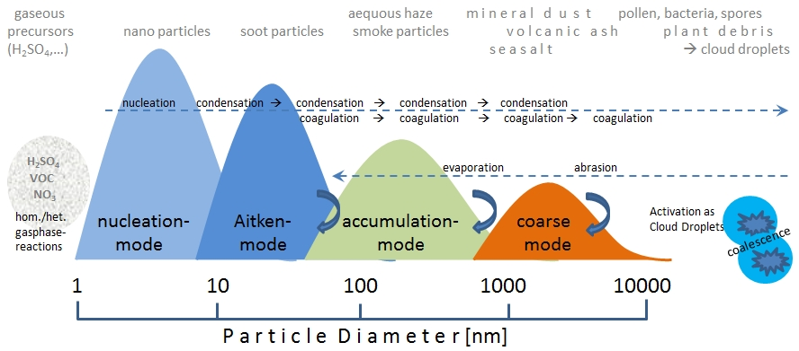
Aerosols

Slide 47
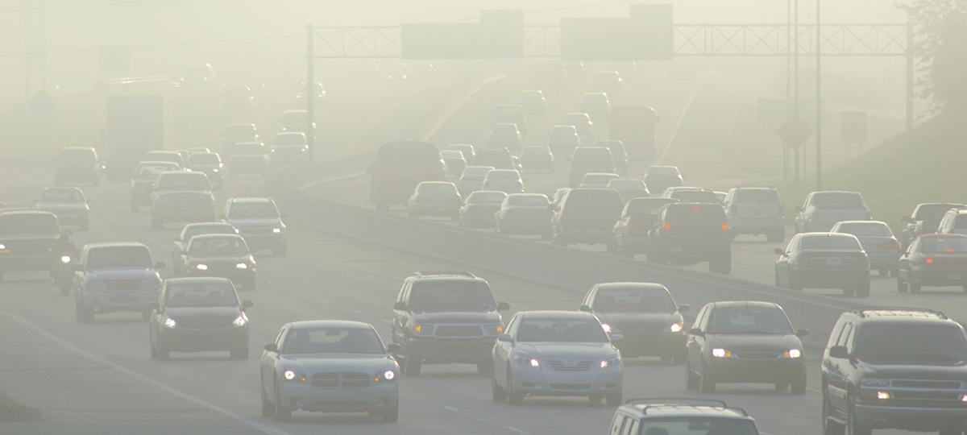

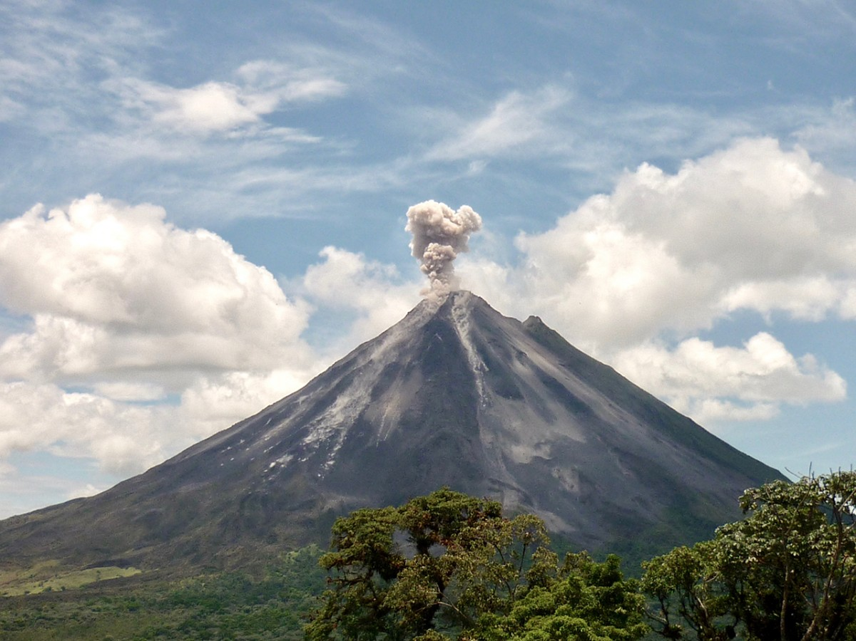
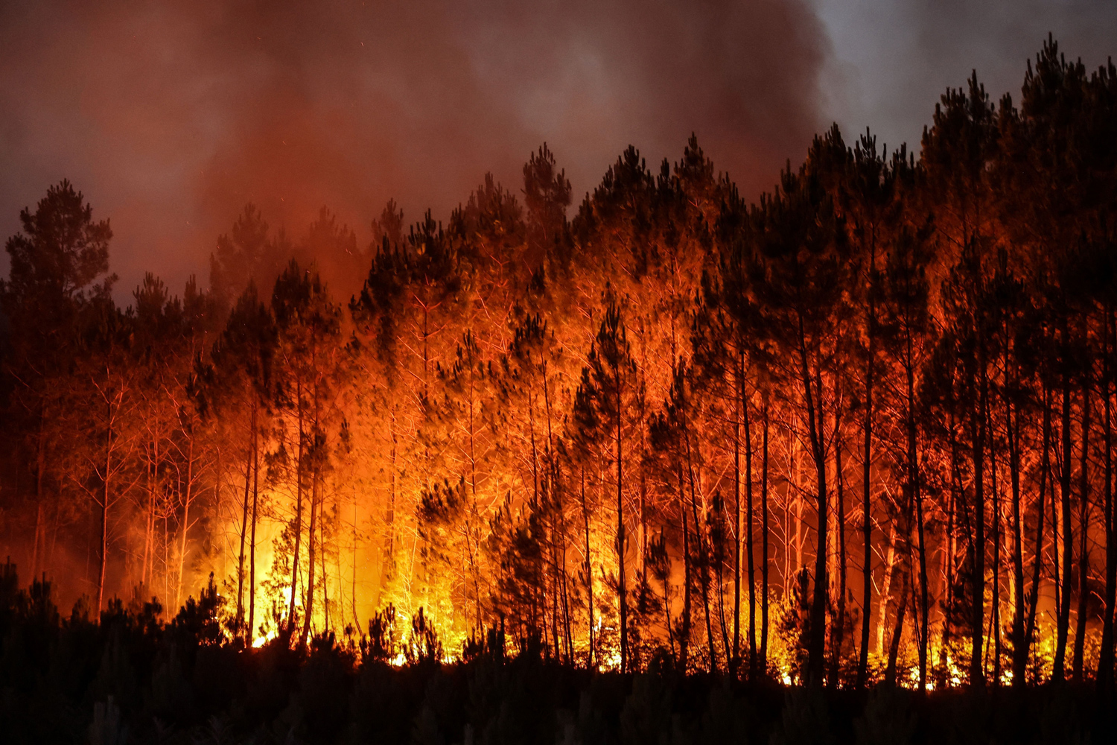
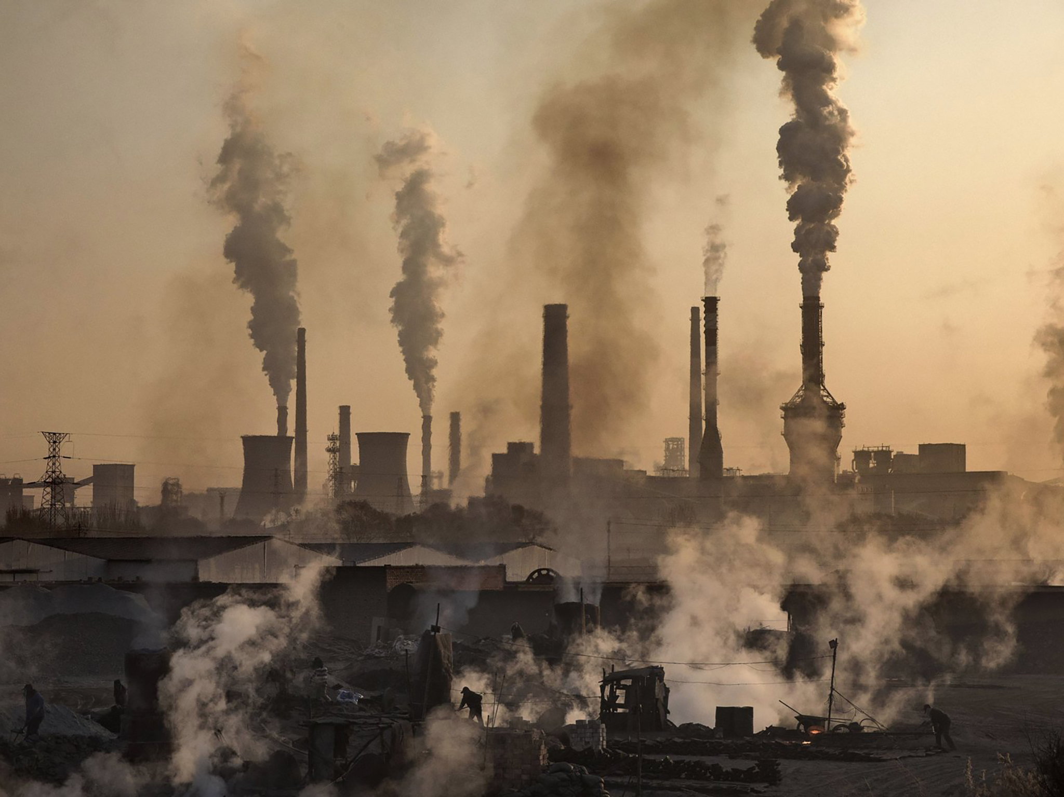

Aerosol sources

Slide 48
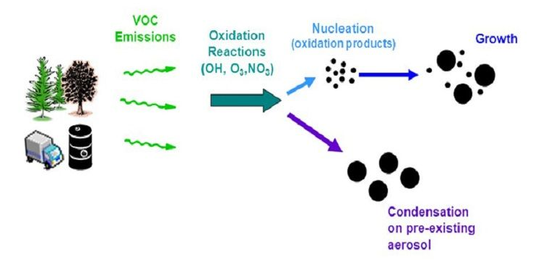
Primary and secondary aerosols

Slide 49
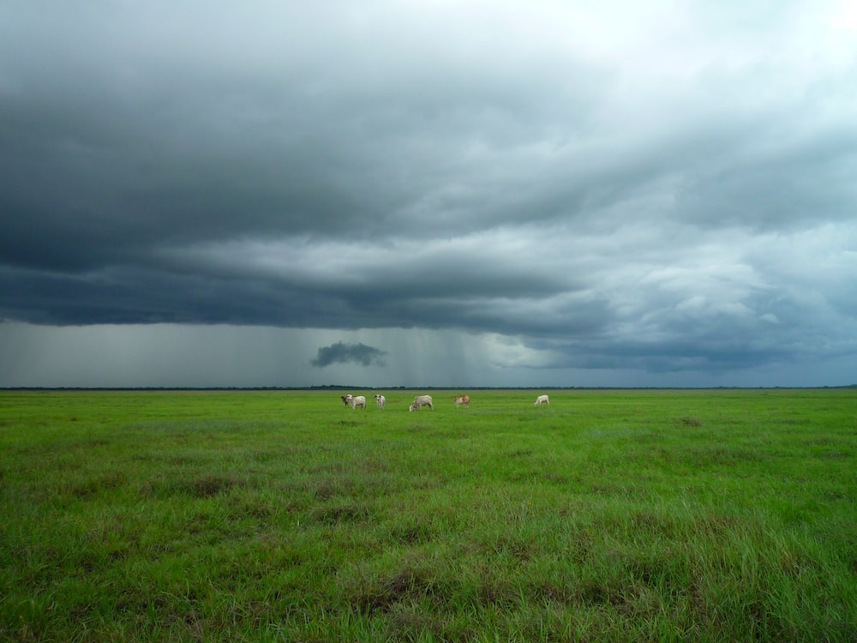
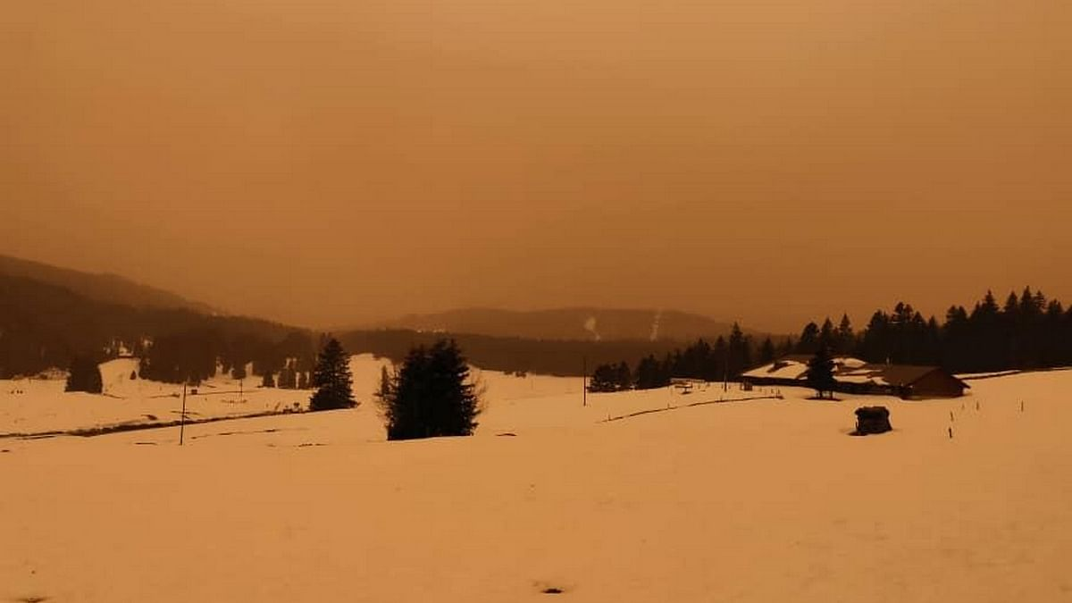
Aerosol removal from the atmosphere through direct deposition or cloud formation

Slide 50
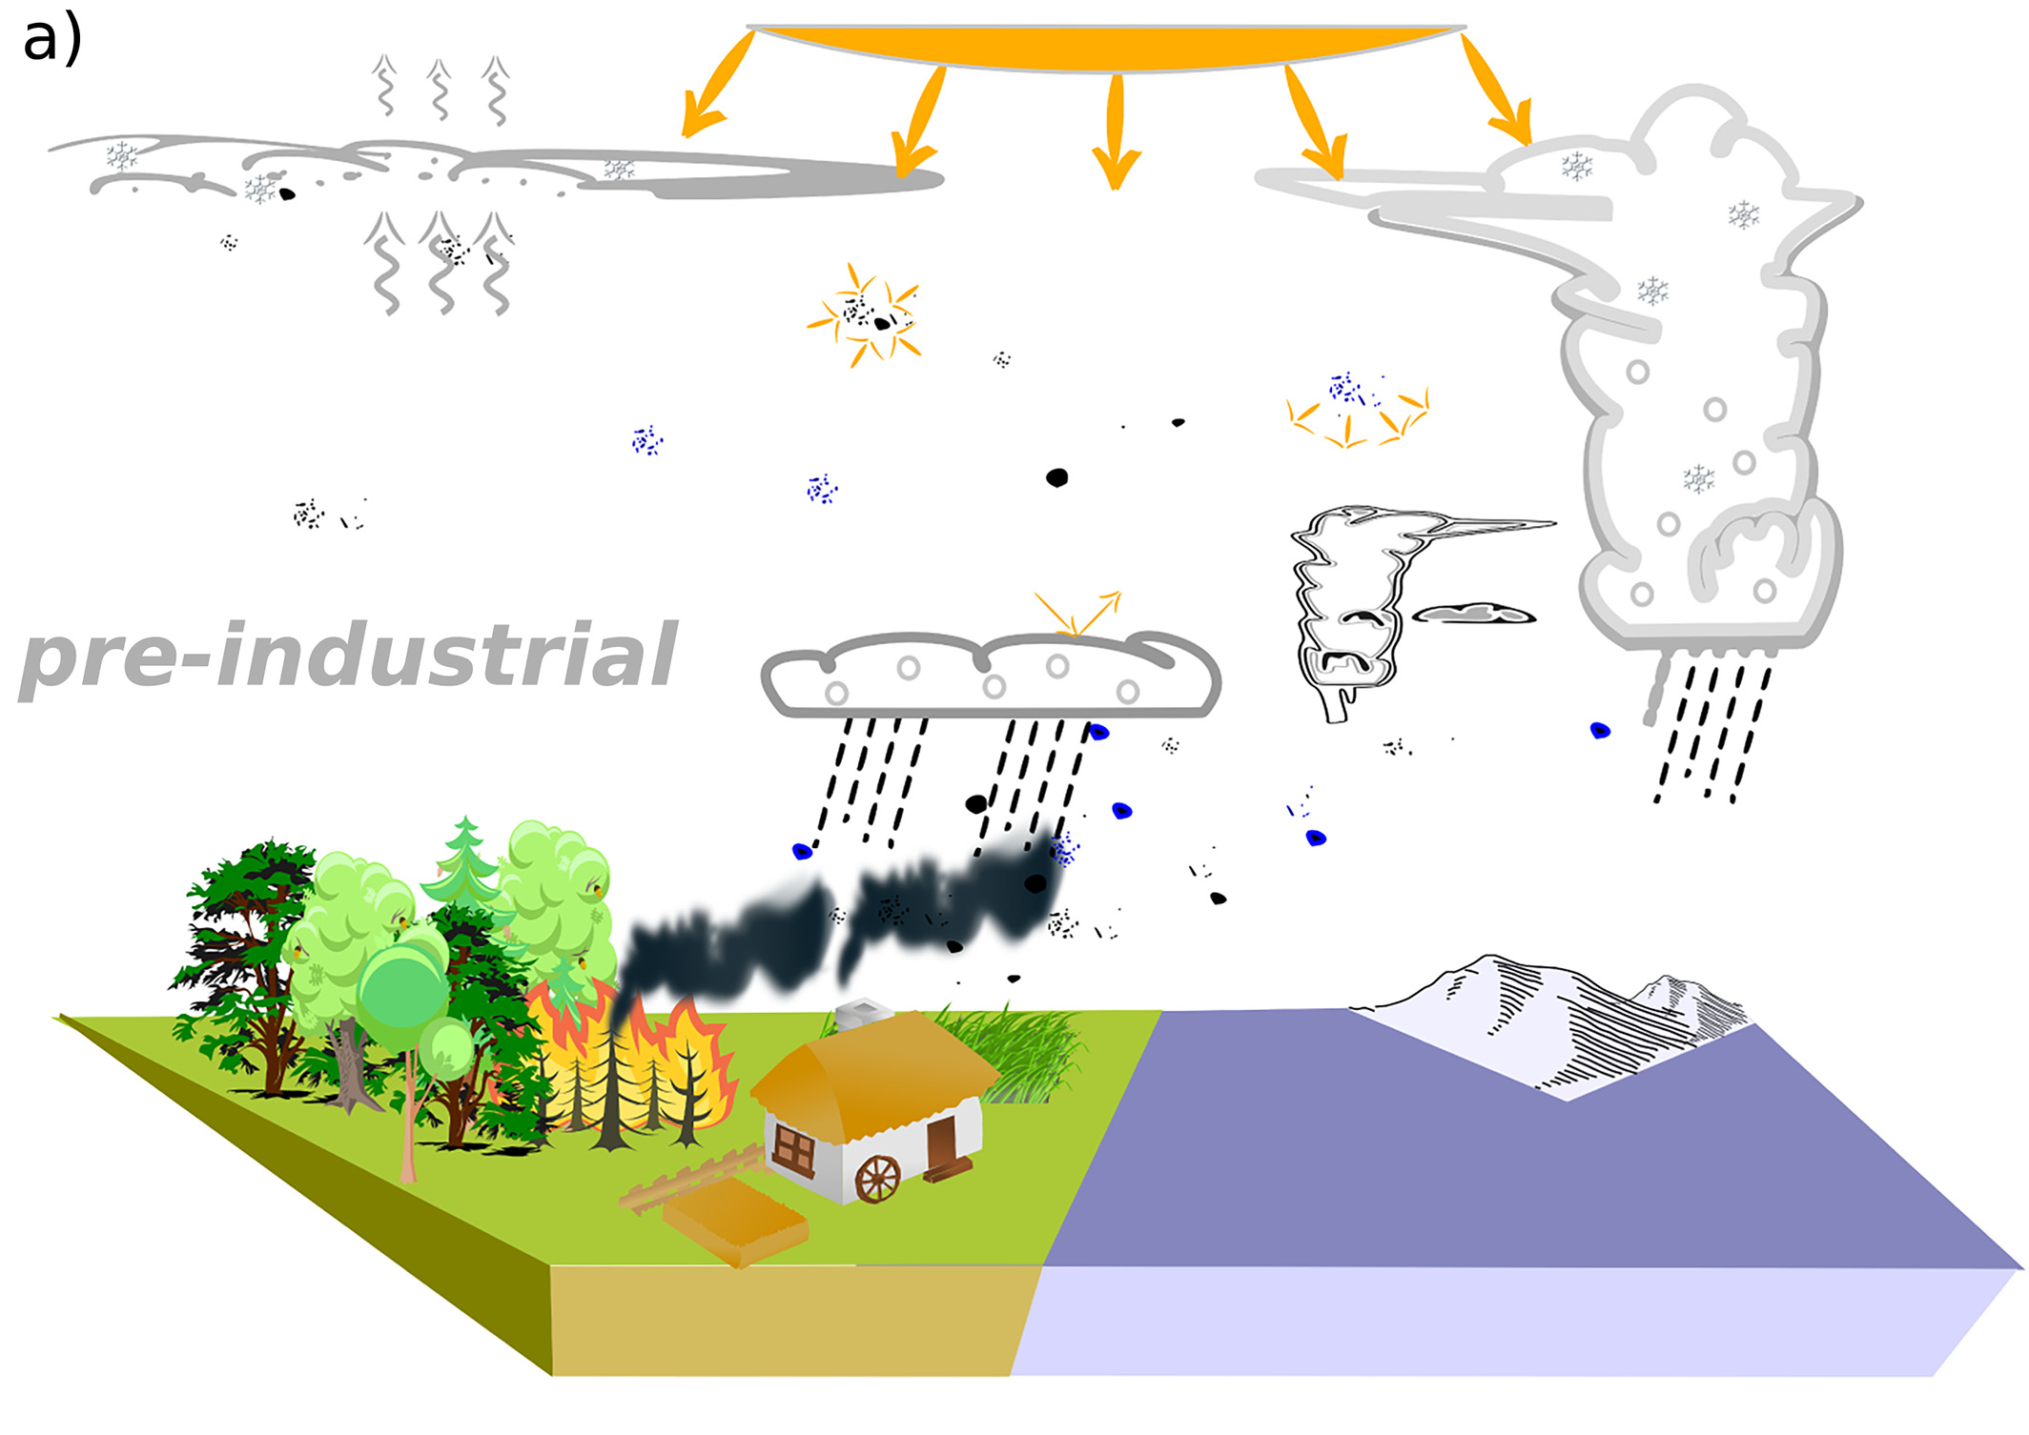
Radiative forcing of aerosols
Aerosols on average have a cooling effect but the exact magnitude is uncertain

Slide 51
Atmosphere
Climate fundamentals
Predicting climate
Atmosphere
Global C cycle
IPCC report
Earth system models
Climate impacts
Climate solutions
Extreme events
Tipping points
Sea ice, ice caps,
Energy
Mitigation
Nature-based solutions

